Slide 1
Review HTML & CSS
Set up Layout with abtributes “display:flex”
A lot of properties are :
flex-direction : row/ column/ column(row)-reserve
flex-wrap :wrap/ nowrap/ wrap-reserve
justify-content : flex-start(end)/ space-around(between)
align-items : flex-start(end)/ center/ stretch/ baseline
align-content : flex-start(end)/ center/ stretch/ baseline

Slide 2
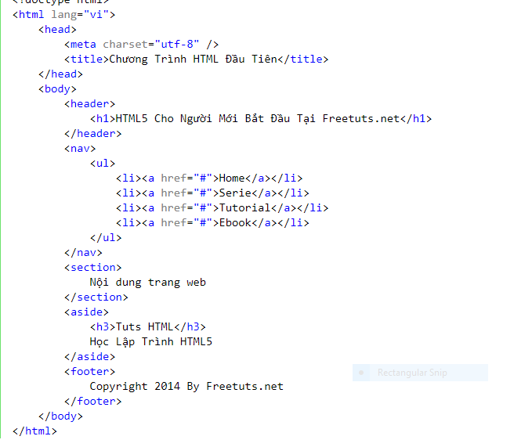
Layout in HTML5

Slide 3
Very Note HTML5
Use id/class to define : header, top, bottom, footer, menu, navigation, main, container, content, article, sidebar, topnav, …
But, this makes search engines (Google) unable to identify content and page structure easily. Therefore, HTML5 was born and contains semantic elements to create a semantic web: "allows data to be shared and reused in many applications, businesses and communities".

Slide 4
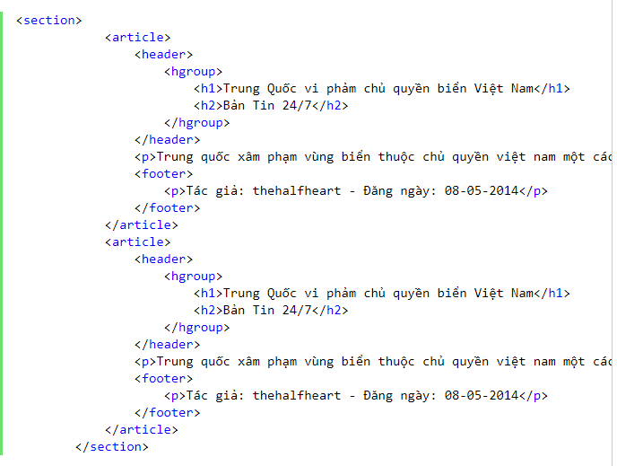
Very Note HTML5
<header> # <head>
<header> and <footer> not only use for the main layout, but also for the article inside. In the header we have html5 <hgroup> to gop the header again.

